Slide 1
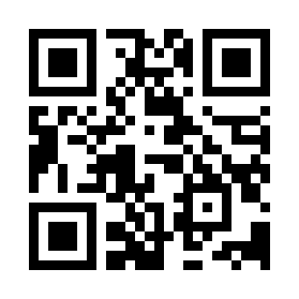
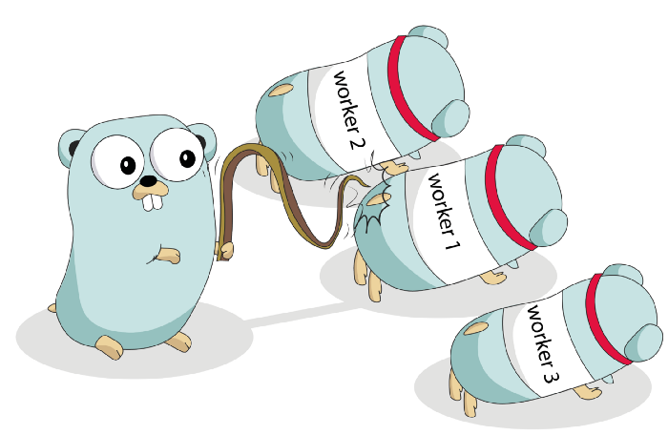
Introduction to Go Quiz
https://bit.ly/3iJJQgE

